Slide 1
RECOVER Closing Conference
WP6: Transmission, epidemiology and modeling
Pr Xavier Duval
Pr Patricia Bruijning-Verhagen
6-7 June 2023
Esplanade Hotel, Zagreb, Croatia
This project has received funding from the European Union’s Horizon 2020 research and innovation programme under grant agreement No 101003589.

Slide 2
Objectives
To study the risk of SARS-CoV2 infection following contacts with confirmed cases
in two settings
At the hospital, among healthcare workers CoV-CONTACT study
In household, among household members The Household study
To understand the key transmission parameters of SARS-CoV-2
To ascertain transmission risk factors
To protect healthcare resources
To help implementing interventions to reduce the risk of transmission

Slide 3
CoV-CONTACT study
Objectives:
- To determine the rate of infected healthcare workers after an « unprotected » Contact to a SARS-Cov2 subject
- To analyze the determinants of transmission

Slide 4
CoV-CONTACT study: Methods
Inclusion: All subjects
Exposed to a SARS-CoV-2 subject in the 14 preceding days and
whose exposure was considered to be at high/moderate risk of SARS-CoV-2 transmission
Endpoint: Definite SARS-CoV-2 infection defined
Either Positive PCR between D0 and D14
OR seroconversion D0-D30
 | High/moderate risk exposure with a Symptomatic confirmed case
AND | Face-to-face
AND | Within 1 meter
AND | Without protection measure (surgical or FFP2 mask)
AND | In the first 72 hours preceding the diagnostic OR after the diagnostic of the confirmed case
AND | During
 | Cough or
 | Sneezing or
 | a discussion.

Slide 5
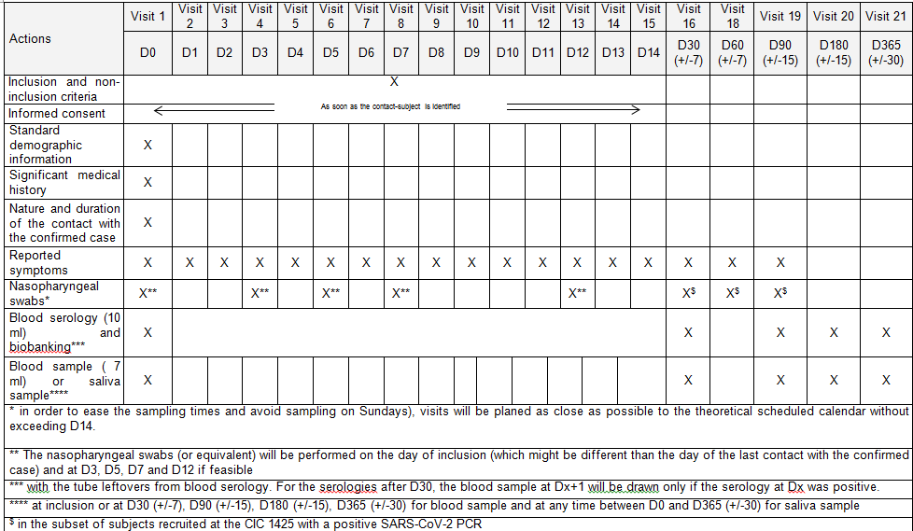
Study flowchart
Methods

Slide 6
CoV-CONTACT study: Results and outcome
Inclusion of 317 HCW between Feb 3th 2020 and July^{1st} 2020
HCW functions:
Doctors: 34 %
Nurses: 51%
Non caregivers: 15%
Comorbidities:
Obesity (BMI>30Kg/m²) 19%
Chronic respiratory diseases 14%

Slide 7
CoV-CONTACT study: Results and outcome
Types of at-risk exposures
1/3 HCW exposed to SARS-CoV2 patients
2/3 HCW exposed to SARS-CoV2 colleagues
Location of the at-risk exposure
During the first period (February 3th to March 18th 2020)
Mainly exposures to SARS-CoV2 patients
No exposure in the Front line units as adherence to PPI was high among HCW
Exposure outside the Front line units with unidentified SARS-CoV2 patients
HCW were not systematically wearing masks in these units which were not supposed to receive SARS-CoV2 infected patients.

Slide 8
CoV-CONTACT study: Results and outcome
Types of at-risk exposures
1/3 HCW exposed to SARS-CoV2 patients
2/3 HCW exposed to SARS-CoV2 colleagues
During the first period (February 3th to March 18th 2020)
Mainly exposures to SARS-CoV2 patients
No exposure in the Front line units as adherence to PPI was high among HCW
Exposures occurred outside the Front line units with unidentified SARS-CoV2 patients
HCW were not systematically wearing masks in these units which were not supposed to receive SARS-CoV2 infected patients.

Slide 9
CoV-CONTACT study: Results and outcome
After March 18th 2020 and generalization of the use of masks in ALL care units
No longer at-risk exposures to SARS-CoV 2 patients
Exposure to SARS-CoV2 colleagues during mask release situations
Professional meetings
Lunch +++
Friendly moments

Slide 10
CoV-CONTACT study: Results and outcome
Transmission rate: 17 % (95%CI: 13 - 23) of HCW acquired SARS-CoV 2 infection
30% of HCW were asymptomatic
Factors associated with infections
Contact with an SARS-CoV2 patients / SARS-CoV2 HCW : OR 2.36 [1.21;4.65]
Nurses than in medical doctors OR: 2.37 [1.11;5.22]
No differences in
HCW background characteristics
Other types of exposure characteristics
Length of exposure
NP viral load of index COVID subjects (Patients or HCW)

Slide 11
CoV-CONTACT study: Results and outcome
Transmission rate: 17 % (95%CI: 13 - 23) of HCW acquired SARS-CoV 2 infection
30% of HCW were asymptomatic
Factors associated with infections
Exposure to an SARS-CoV2 patient / SARS-CoV2 HCW : OR 2.36 [1.21;4.65]
Nurses than in medical doctors OR: 2.37 [1.11;5.22]
No differences in
HCW background characteristics
Other types of exposure characteristics
Length of exposure
NP viral load of index COVID subjects (Patients or HCW)

Slide 12
CoV-CONTACT study: Conclusions
Almost 15% of HCW were infected after an at-risk exposure
Exposures were both due to infected patients and infected colleagues
In the absence of shortage, generalize the use of mask in all units, including those not suppose to receive infected pts
Lunch and Friendly moments at high risk of exposure between HCW
The RISK of HCW infection become more related to situations outside the patients care
- at hospital between colleagues
- outside the hospital (family, private contacts) were masking was unfeasible.

Slide 13
CoV-CONTACT study: Conclusions
Almost 15% of HCW were infected after an at-risk exposure
Exposures were both due to infected patients and infected colleagues
In the absence of shortage, generalize the use of mask in all units, including those not suppose to receive infected pts
Lunch and Friendly moments at high risk of exposure between HCW
The RISK of HCW infection become more related to situations outside the patients care
- at hospital between colleagues
- outside the hospital (family, private contacts) were masking was unfeasible.

Slide 14
CoV-CONTACT study: Conclusions
Almost 15% of HCW were infected after an at-risk exposure
Exposures were both due to infected patients and infected colleagues
In the absence of shortage, generalize the use of mask in all units, including those not suppose to receive infected pts
Lunch and Friendly moments are at high risk of exposure between HCW
The RISK of HCW infection become more related to situations outside the patients’ care
- at hospital: between colleagues
- outside the hospital : family, private contacts where masking was unfeasible.

Slide 15
Lessons learned
Pending the development of vaccines, how can HCW be effectively protected during ALL their high-risk contacts?
Pre exposition chemoprophylaxis ?

Slide 16
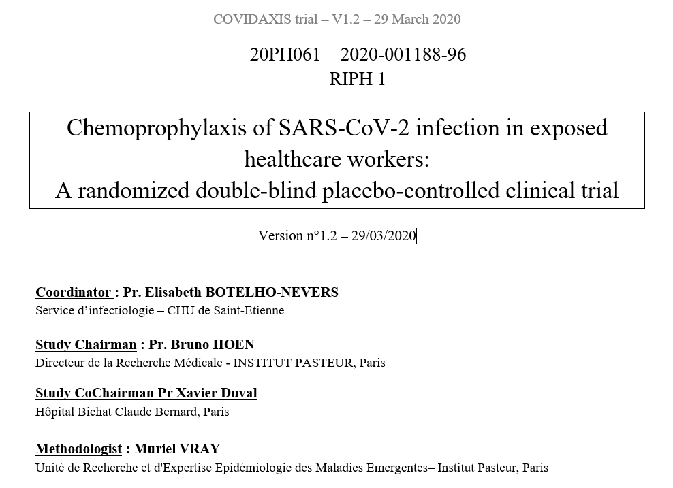
Lessons learned
COVIDAXIS 1 Trial

Slide 17
Lessons learned
Primary objective (COVIDAXIS Trial)
To explore whether a 2-month treatment with HCQ may reduce the incidence of symptomatic or asymptomatic infection by SARS-CoV-2, in HCW.
HCW randomly assigned to
Arm HCQ: HCQ 200 mg (2 tablets td at Day 1 and 200 mg, 1 tablet once daily afterwards)
Arm PCB: Placebo of HCQ (2 tablets td at Day 1 and 200 mg, 1 tablet once daily afterwards)

Slide 18
Lessons learned
Primary endpoint
Occurrence of an symptomatic or asymptomatic SARS-CoV-2 infection among HCWs
defined by either:
• a positive RT-PCR on
periodic systematic nasopharyngeal swab OR
a respiratory sample in case of symptoms OR
• a seroconversion to SARS-CoV-2 after randomization.
Hypothesis:
Reduction of the rate of infected HCW from 15% to 7.5%
Inclusion of 300 HCW per arms

Slide 19
Lessons learned
Primary endpoint
Occurrence of an symptomatic or asymptomatic SARS-CoV-2 infection among HCWs
defined by either:
• a positive RT-PCR on
periodic systematic nasopharyngeal swab OR
a respiratory sample in case of symptoms OR
• a seroconversion to SARS-CoV-2 after randomization.
Hypothesis:
Reduction of the rate of infected HCW (50%) from 15% to 7.5%
Inclusion of 300 HCW per arms

Slide 20
Lessons learned
Inclusion started on May 2nd 2020
80 HCW included in 15 days

Slide 21
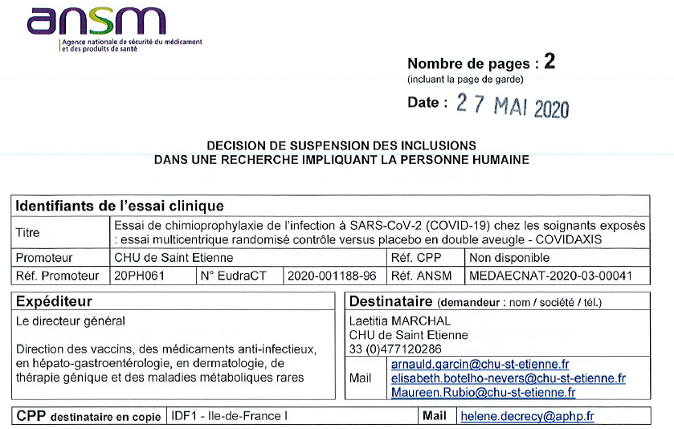
Lessons learned
French Drug agency ordered suspension of inclusion on May 27th 2020 of all RCT with Hydroxychloroquine

Slide 22
Lessons learned
Pending the development of vaccines, how can HCW be effectively protected during all their high-risk contacts?
POST exposition chemoprophylaxis at home ?

Slide 23
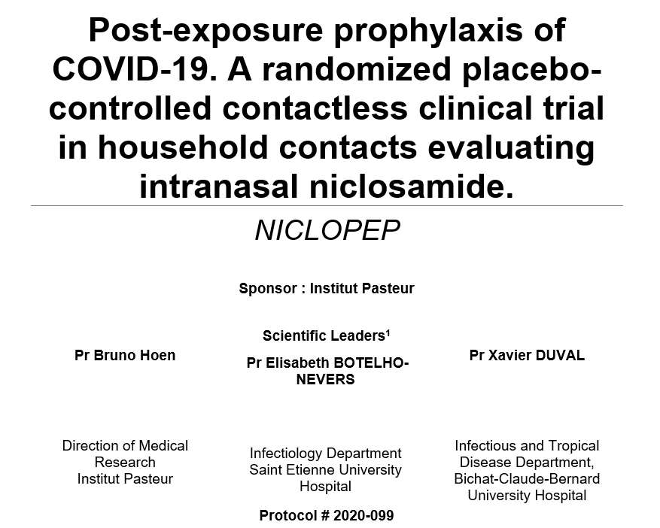
Lessons learned
COVIDAXIS 2 Trial

Slide 24
Lessons learned
Objective: To evaluate the efficacy of NICLOSAMIDE as a post-exposure chemoprophylaxis agent in reducing the incidence of symptomatic SARS-CoV-2 infection in household contact subjects, compared to placebo.
Primary Endpoint: Number of symptomatic SARS-CoV-2 infections in each randomization arm at day 14
Inclusion: Asymptomatic adult household contacts of subjects with confirmed COVID-19.
Number of subjects: With a power of 80%, a type 1-error 5% two-sided, the number of participants is estimated at 477 per arm (954 in total).

Slide 25
Lessons learned
Objective: To evaluate the efficacy of NICLOSAMIDE as a post-exposure chemoprophylaxis agent in reducing the incidence of symptomatic SARS-CoV-2 infection in household contact subjects, compared to placebo.
Primary Endpoint: Number of symptomatic SARS-CoV-2 infections in each randomization arm at day 14
Inclusion: Asymptomatic adult household contacts of subjects with confirmed COVID-19.
Number of subjects: With a power of 80%, a type 1-error 5% two-sided, the number of participants is estimated at 480 per arm (960 in total).

Slide 26
Lessons learned
Modeling the impact of antiviral treatment against SARS-CoV-2 in households
Hind Zaaraoui, Xavier Duval, Bruno Hoen, Lulla Opatowski, Jérémie Guedj

Slide 27
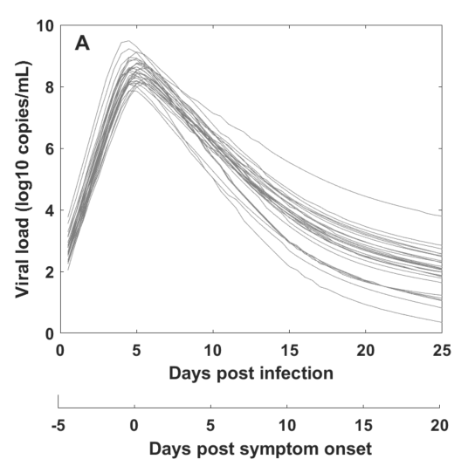
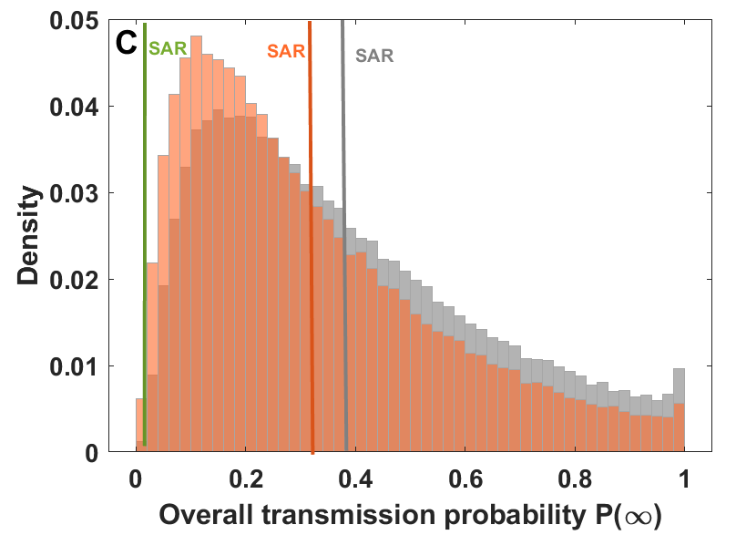
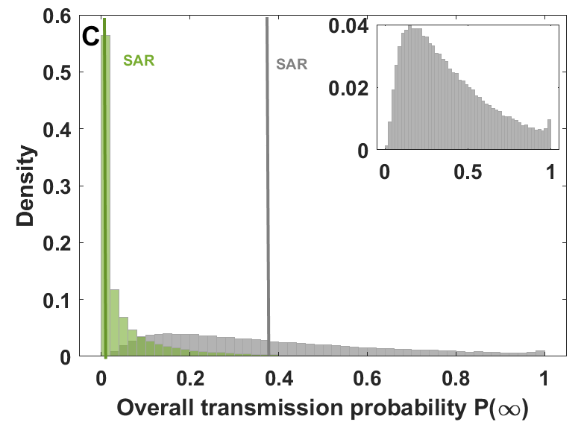
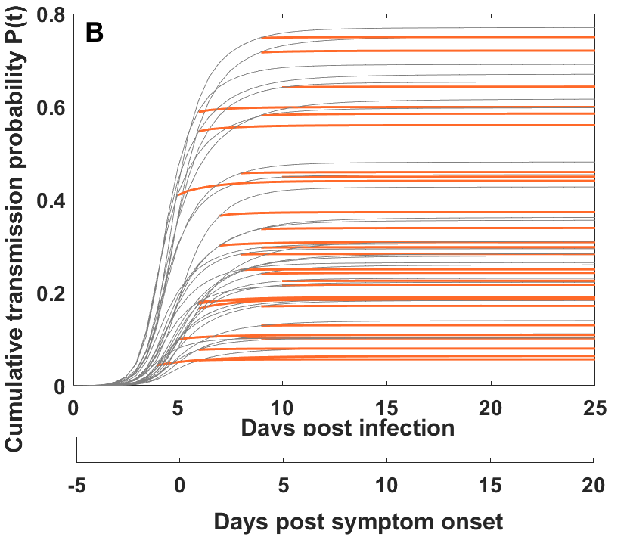
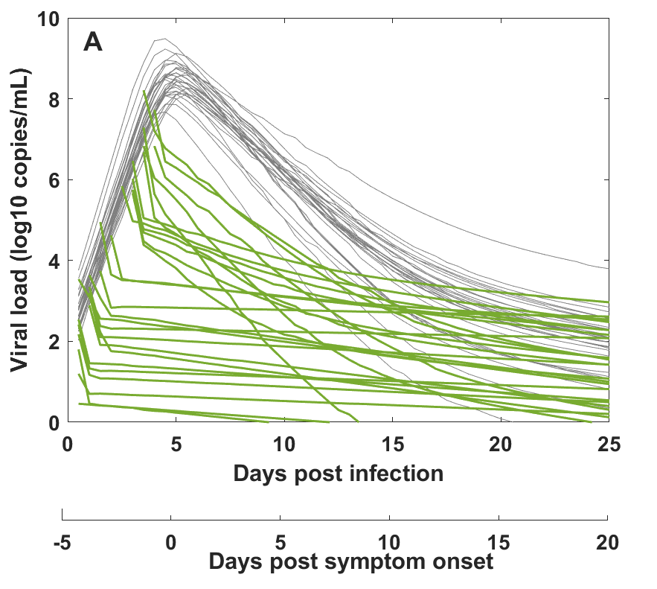
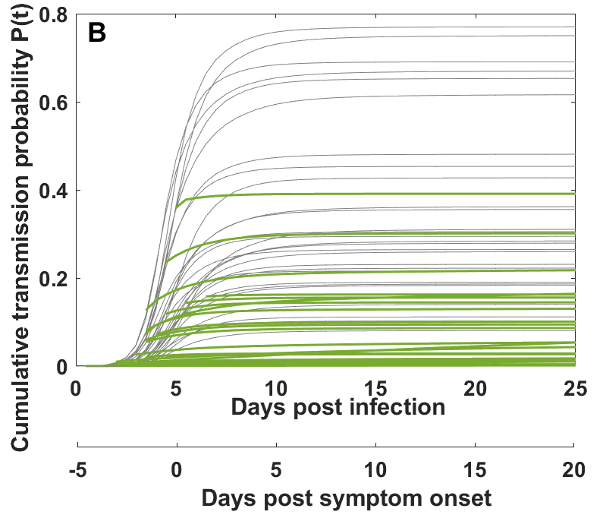
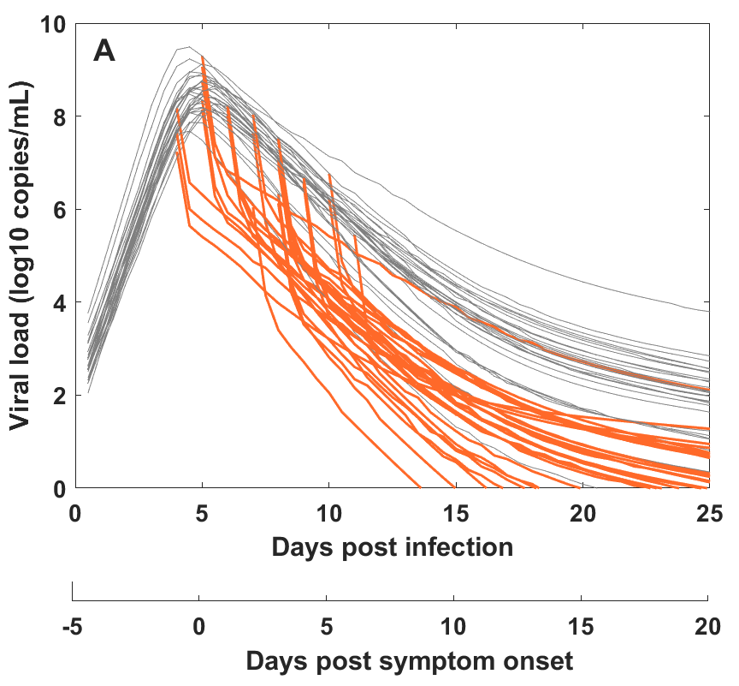
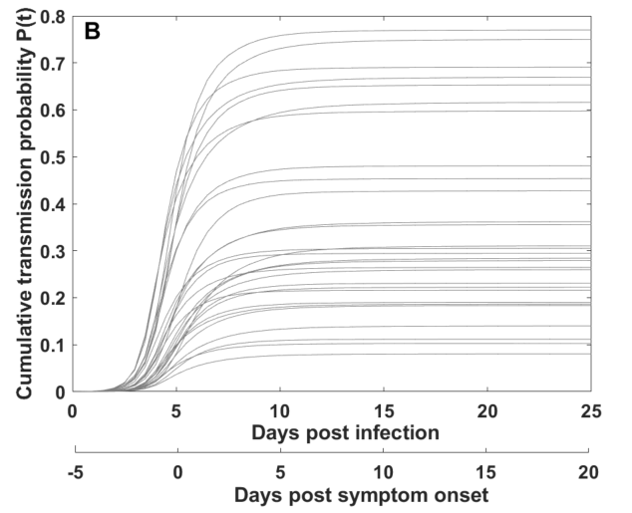
Multiscale model Including treatment on the viral kinetics model
$$\frac{dT}{dt}=−βTV_{I}$$
$$\frac{dI_{1}}{dt}=βTV_{I}−kI_{1}$$
$$\frac{dI_{2}}{dt}=kI_{1}−δI_{2}−φ\frac{F}{F+θ}I_{2}$$
$$\frac{dV_{I}}{dt}=μp{(1−ε_{ })I}_{2}−cV_{I}$$
$$\frac{dV_{NI}}{dt}=\left(1−μ\right)(1−ε_{ })pI_{2}−cV_{NI}$$
$$\frac{dF}{dt}=I_{2}−d_{f}F$$
T
$$β$$
$$I_{1}$$
$$\frac{dT}{dt}=−βTV_{I}$$
$$\frac{dI_{1}}{dt}=βTV_{I}−kI_{1}$$
$$\frac{dI_{2}}{dt}=kI_{1}−δI_{2}−φ\frac{F}{F+θ}I_{2}$$
$$\frac{dV_{I}}{dt}=μpI_{2}−cV_{I}$$
$$\frac{dV_{NI}}{dt}=\left(1−μ\right)pI_{2}−cV_{NI}$$
$$\frac{dF}{dt}=I_{2}−d_{f}F$$
$$V_{I}$$
$$k$$
$ε=99\%$: antiviral treatment efficacy¹
$$μp(1−ε)$$
$$c$$
$$I_{2}$$
$$V_{NI}$$
$$δ$$
$$c$$
$$(1−μ)p(1−ε)$$
F
$$φ,θ$$
$$m=4,1×{10}^{−6} →SAR=0.38 (Wuhan)$$
$$m=4,1×{10}^{−6} →SAR=0.05 (Wuhan)$$
$$m=4,1×{10}^{−6} →SAR=0.32 (Wuhan)$$
(1) Conrado et al, CROI (2022)
Notes:
We integrate here the treatment in our model which impact at the same time the infection of the target cell with parameter epsilon and also the number of created viruses with same parameter epsilon. The higher the epsilon the higher the impact of the treatment.
So the treatment decrease the viral load dynamics rapidly just after treatment initiation and same for the SAR. Treating before the viral peak prevents from the highest transmission probabilities however if we treat after the peak that may not reduce the transmission probability

Slide 28
Who should be treated within a Household ?
Strategy 0 No treatment
Strategy 1 Treat only the index individual upon diagnosis
Strategy 2: Treat all household upon diagnosis of the index
(index + other HH members)
: Infected
: Recovered
: Susceptible
Notes:
The first scenario is no treatment: as precised before, the incubation period is 5 days so the infection is 5 days before the symptoms. As soon as the index is infected he can transmit the virus to all the contacts over time in the HH. If another member is infected he can also infect another susceptible HH members and etc. At the end of the outbreak we can compute the proportion of the infected indiv and the sum of the AUC.
In the scenario 2 of the only index is treated, The index is infected and 5 days later he may have symptoms and so the treatment is supposed to be initiated randomly 0 to 5 days after the symptoms which is equivalent to 5 to 10 days after infection, which is some how late. All the other individuals are not treated. This treatment may impact the proportion of infected individuals and also the HH viral burden even if the treatment comes later after the viral peak and that some of the contacts have been already infected before the inclusion.
For the scenario 3 OF ALL THE HH is treated, The index is the first infected individual and may have symptoms 5 days later, so at 0 to 5 days after Index symptoms. All the HH members either they are infected or not infected are treated at the same time as the index. The treatment comes in this scenario also later after the Index viral peak and some of the contacts have been already infected before the inclusion. However the HH viral burden may have been much more impacted by this scenario than the previous one
So we define two objectives here

Slide 29
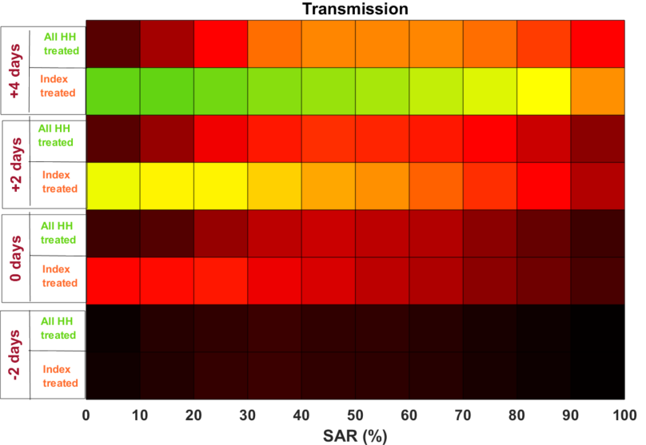
Treatment is effective when symptom onset precedes peak viral load by >2 days and SAR>30%
In the conditions of SARS-CoV-2 virus
(symptom onset = time to peak = 5 days),
Strategies targeting the index individual do not substantially reduce the attack rate and the virological burden
Universal treatment upon index diagnosis may reduce virological burden
Time to peak – Time to symptom onset
Treatment effectiveness

Slide 30
Recommendations for scientists, healthcare workers and policy makers
HCW are exposed to SARS-CoV 2 transmission within hospital
In the absence of mask shortages, the mask must be worn by all caregivers, regardless of the unit in which they work.
HCW must be protected from at-risk exposure both inside (with patients and other HCW) and outside the hospital.
Pre Exposure drug prophylaxis should be evaluated for HCW in order to preserve their ability to provide care (could ensure an overall protection).
Post Exposure prophylaxis
is technically complicated to implement
seems to be effective only under very restrictive conditions

Slide 31
Recommendations for scientists, healthcare workers and policy makers
HCW are exposed to SARS-CoV 2 transmission within hospital
In the absence of mask shortages, the mask must be worn by all HCW, regardless of the unit in which they work.
HCW must be protected from at-risk exposure both inside (with patients and other HCW) and outside the hospital.
Pre Exposure drug prophylaxis should be evaluated for HCW in order to preserve their ability to provide care (could ensure an overall protection).
Post Exposure prophylaxis
is technically complicated to implement
seems to be effective only under very restrictive conditions

Slide 32
Recommendations for scientists, healthcare workers and policy makers
HCW are exposed to SARS-CoV 2 transmission within hospital
In the absence of mask shortages, the mask must be worn by all HCW, regardless of the unit in which they work.
HCW must be protected from at-risk exposure both inside (with patients and other HCW) and outside the hospital.
Pre Exposure drug prophylaxis should be evaluated for HCW in order to preserve their ability to provide care (could ensure an overall protection).
Post Exposure prophylaxis
is technically complicated to implement
seems to be effective only under very restrictive conditions

Slide 33
Recommendations for scientists, healthcare workers and policy makers
HCW are exposed to SARS-CoV 2 transmission within hospital
In the absence of mask shortages, the mask must be worn by all HCW, regardless of the unit in which they work.
HCW must be protected from at-risk exposure both inside (with patients and other HCW) and outside the hospital.
Pre Exposure drug prophylaxis should be evaluated for HCW in order to preserve their ability to provide care (could ensure an overall protection).
Post Exposure prophylaxis
is technically complicated to implement
seems to be effective only under very restrictive conditions

Slide 34
Recommendations for scientists, healthcare workers and policy makers
HCW are exposed to SARS-CoV 2 transmission within hospital
In the absence of mask shortages, the mask must be worn by all HCW, regardless of the unit in which they work.
HCW must be protected from at-risk exposure both inside (with patients and other HCW) and outside the hospital.
Pre Exposure drug prophylaxis should be evaluated for HCW in order to preserve their ability to provide care (could ensure an overall protection).
Post Exposure prophylaxis
is technically complicated to implement
seems to be effective only under very restrictive conditions

Slide 35
Q&A

