Slide 1
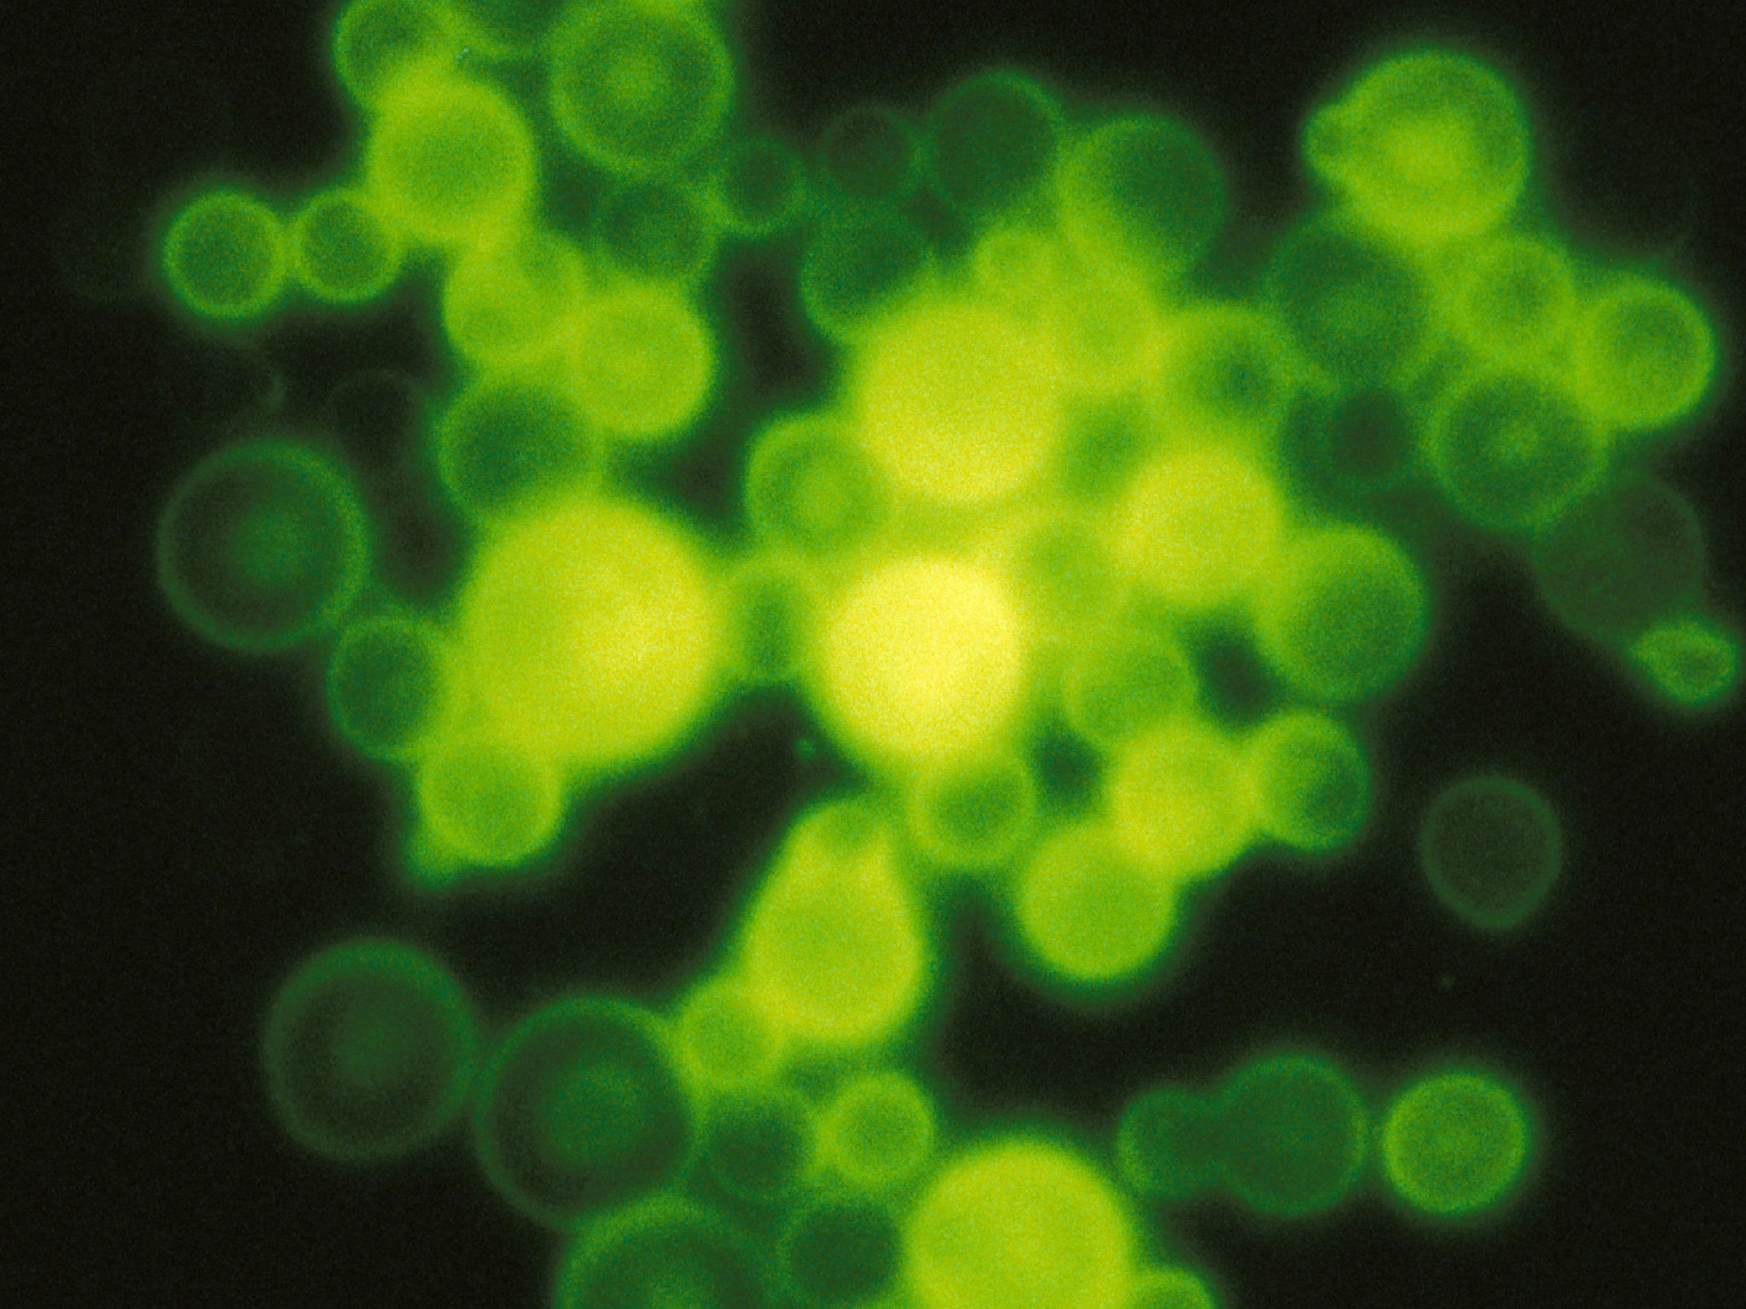
Prior infection by seasonal coronaviruses does not prevent SARS-CoV-2 infection and associated Multisystem Inflammatory Syndrome in children
Isabelle Sermet-Gaudelus^{1,2,3*,} Sarah Temmam^{4*,} Christèle Huon⁴, Sylvie Behillil^{5,6}, Vincent Gajdos^{7,8,} Thomas Bigo^{t4,9}, Thibaut Lurier^{10,11,12}, Delphine Chrétien⁴, Marija Backovic¹³, Agnès Moisan-Delaunay^{14,} Flora Donati^{5,6}, Mélanie Albert^{5,6}, Elsa Foucaud¹⁵, Bettina Mesplées¹⁶, Grégoire Benoist¹⁷, Albert Faye¹⁸, Marc Duval-Arnould¹⁹, Célia Cretolle², Marina Charbit², Mélodie Aubart², Johanne Auriau², Mathie Lorrot²⁰, Dulanjalee Kariyawasam2, Laura Fertitta², Gilles Orliaguet^{2,} Bénédicte Pigneur², Brigitte Bader-Meunier², Coralie Briand¹⁶, Vincent Enouf^{5,6,21}, Julie Toubiana^{2,3,22}, Tiffany Guilleminot²³, Sylvie van der Werf^{5,6}, Marianne Leruez-Ville²³, Marc Eloit^{4,24}.
* Equal contribution
1-Institut Necker Enfants Malades, INSERM U 1171. Paris 75015, Paris France
2-Hôpital Necker-Enfants Malades. Assistance Publique Hôpitaux de Paris. Paris 75015. France
3-Université de Paris. Paris 75015, France
4-Pathogen Discovery Laboratory, Department of Virology, Institut Pasteur, Paris, France
5-Molecular Genetics of RNA Viruses, Department of Virology, CNRS UMR3569, University of Paris, Institut Pasteur, Paris, France
6-National Reference Center for Respiratory Viruses, Institut Pasteur, Paris, France
7-Hôpital Antoine Beclere. 92140 Clamart, France
8-Centre for Research in Epidemiology and Population Health, INSERM UMR1018, Villejuif, France
9-Hub de Bioinformatique et Biostatistique – Département Biologie Computationnelle, Institut Pasteur, USR 3756 CNRS, Paris, France
10-Université Clermont Auvergne, INRAE, VetAgro Sup, UMR EPIA, F-63122 Saint-Genès-Champanelle, France
11-Université de Lyon, INRAE, VetAgro Sup, UMR EPIA, F-69280 Marcy l’Etoile, France
12-Université de Lyon, INRAE, VetAgro Sup, Usc 1233 UR RS2GP, F-69280 Marcy l’Etoile, France
13-Structural Virology Unit, Institut Pasteur, Paris 75015, France
14-Université Paris-Saclay, CEA, CNRS, Institute for Integrative Biology of the Cell (I2BC), 91198, Gif-sur-Yvette, France
15-Hôpital Jean Verdier. 93140 Bondy, France
16-Hôpital Louis Mourier. 92700 Colombes. France
17-Hôpital Ambroise Paré. Boulogne Billancourt 92100. France
18-Hôpital Robert Debré. Paris 75019. France
19-Hôpital Kremlin Bicêtre. 94270 Le Kremlin-Bicêtre. France
20-Hôpital Armand Trousseau. 75012 Paris. France
21-Plateforme de microbiologie mutualisée (P2M), Pasteur International Bioresources Network (PIBnet), Institut Pasteur, Paris, France
22-Unité Biodiversité et Epidemiologie des Bacteries Pathogènes, Institut Pasteur, Paris, France
23-Laboratoire de Microbiologie, Hôpital Necker-Enfants Malades ; Paris 75015, France
24-Ecole Nationale Vétérinaire d’Alfort, 94704 Maisons Alfort, France
Corresponding author: Marc Eloit marc.eloit@pasteur.fr, Institut Pasteur, 28 rue du Dr Roux, 75015 Paris-F

Slide 2
Introduction
Children less likely to develop COVID-19 and clinical course less severe than in adults,
Differences in susceptibility profiles might be driven by infections with seasonal human coronaviruses (HCoVs), very frequent at a very young age and that could lead to cross-protective immunity in children.
Multisystem Inflammatory Syndrome (MIS) in children infected by SARS-CoV-2 shares similarities with classic Kawasaki disease but displays different prominent clinical signs including cardiogenic shock or myocarditis
Role for a low antibody response to SARS-CoV-2, or cross-reactive antibodies without any neutralizing capability: immune-dependent enhancement following re-exposure?
Objectives
study the impact of prior infections with seasonal HCoVs on the risk of infection by SARS-CoV-2. Abs as an evidence of past infection by HCoVs, the intensity of the antibody response reflecting partly the degree of replication within the host
analyse SARS-CoV-2 and seasonal HCoVs humoral responses of patients with MIS regarding antibody targets and functional neutralizing activity

Slide 3
Serological tests
1/ Luciferase ImmunoPrecipitation System : LIPS
SARS-CoV-2 seroprevalence : N/S1/S2
SARS-CoV-2, HKU1,OC43, 229E, NL63 comparison: N and S (trimeric, prefusion)
2/ Pseudoneutralisation (Lentivirus pseudotyped with S) : P Charneau lab.: PNT
3/ Neutralisation (Plaque Reduction Assay, live SARS-CoV-2) : S van der Werf lab. : PRNT
293 cells

Slide 4
Evaluation on pre-epidemic sera: Distribution of Abs responses to SARS-CoV-2 and seasonal HCoVs in pre epidemic sera from adults and infants
SARS-CoV-2
SARS-CoV-2

Slide 5
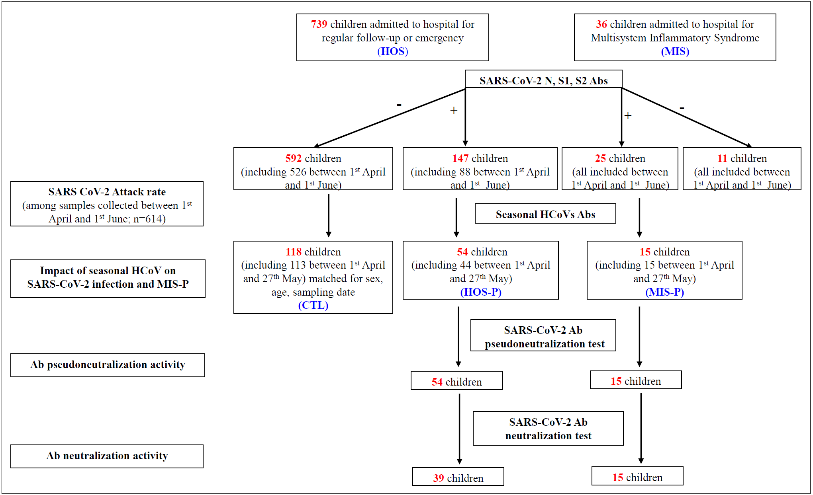
Flowchart of inclusions

Slide 6
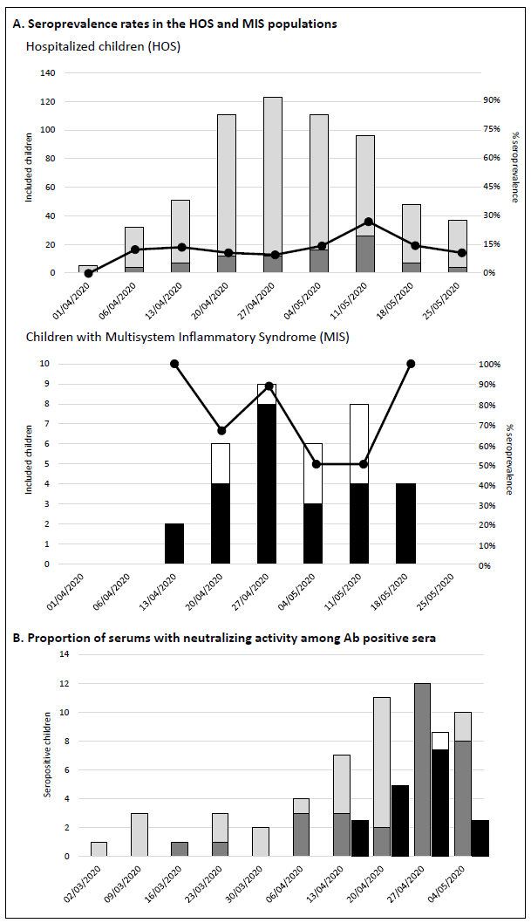
Evolution of the prevalence of antibodies to SARS-CoV-2 and neutralizing activity in children during the epidemic
a-or pauci-symptomatic : Prevalence 11,7% April 1-June 1
No significant differences for age, sex ratio, reasons for hospitalization and main comorbidities
History of contact with a suspected COVID-19 household OR 2.25, 95% CI [1.3; 3.9].
MIS: : Prevalence 69,4%
55·6% of HOS-P and #100% of MIS-P were PNT+
Fraction of HOS-P that were PNT+ increased from 18% to 38% (March and April) to 100% at the beginning of May.
All tested sera positive in PNT (n=28) were PRNT+ and 2 out of the 11 PNT-negative sera were also PRNT+
In total, 73·7% of HOS-P tested sera showed a neutralizing activity.

Slide 7
SARS-CoV-2 Ab in MIS-P
compared to a/pauci-symptomatic children (HOS-P)

Slide 8
Flowchart of inclusions

Slide 9
Prevalence of prior infections with seasonal H-CoV among SARS-CoV-2 seropositive HOS-P, MIS-P and seronegative CTL
Virus | Antigen | HOS-P | MIS-P | CTL | p (CTL vs HOSP-P) | p (CTL vs MIS-P)
SARS-CoV-2 | S | 31/62 (50·0%) | 17/19 (89·5%) | 1/127 (0·79%) | < 10-8 | < 10-8
 | N | 33/62 (53·2%) | 18/19 (94·7%) | 0/127 (0·0%) | < 10-8 | < 10-8
HCoV-HKU1 | S | 54/62 (87·1%) | 19/19 (100·0%) | 111/127 (87·4%) | NS | NS
 | N | 23/62 (37·1%) | 13/19 (68·4%) | 59/127 (46·5%) | NS | NS
HCoV-OC43 | S | 58/62 (93·5%) | 19/19 (100·0%) | 123/127 (96·9%) | NS | NS
 | N | 22/62 (35·5%) | 14/19 (73·7%) | 50/127 (39·4%) | NS | 0·00624
HCoV-229E | S | 49/62 (79·0%) | 15/19 (78·9%) | 87/127 (68·5%) | NS | NS
 | N | 15/62 (24·2%) | 10/19 (52·6%) | 38/127 (29·9%) | NS | NS
HCoV-NL63 | S | NA | NA | NA | NA | NA
 | N | 56/62 (90·3%) | 17/19 (89·5%) | 112/127 (88·2%) | NS | NS

Slide 10
SARS-CoV2 and seasonal HCoVs quantitative responses in HOS-P, MIS-P and CONTROL children

Slide 11
Association between SARS-CoV2 and seasonal HCoVs quantitative responses against each Ag in HOS-P, MIS-P and CONTROL children

Slide 12
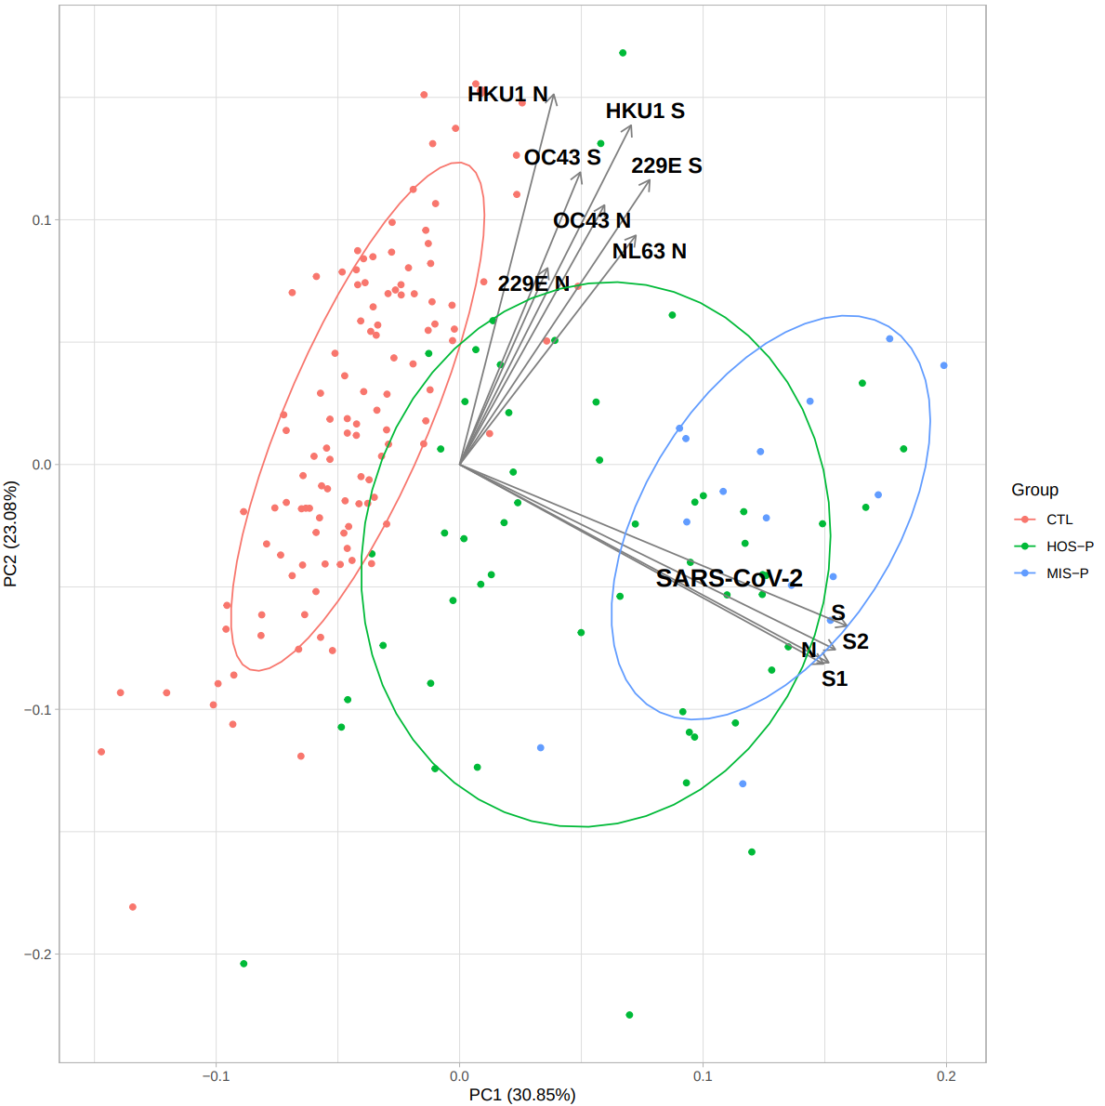
Quantitative analysis of Abs against SARS-CoV2 S, S1, S2, N and seasonal HCoV S and N

Slide 13
Seasonal HCoVs Abs do not segregate HOS-P, MIS-P and CONTROL children
N
S

Slide 14
CONCLUSION
Near 800 children, April to May, Paris : prevalence rate SARS-CoV-2 Abs : 10-15%
Risk not related to age, contact with a parent suspected of COVID-19 x 2·5 risk
More than 50% of the seropositive children did not report any symptoms (idem adults)
Half of SARS-CoV-2 positive sera with neutralizing activity, increased up to 100% at the end of the observation period
Antibodies unlikely to act as primary effectors of protection (no or very low cross binding/ neutralization between these coronaviruses), but served as an indicator of underlying cellular responses : no evidence of cross-protective immunity linked to previous infection by seasonal HCoVs against SARS-CoV-2 infection and MIS
1/similar seasonal HCoV prevalence in SARS-CoV-2 positive versus negative patients.
2/ no significant correlation between SARS-CoV-2 and any HCoV antibody titres, whatever the antigen considered (S or N).
contrasts with the demonstration of pre-existing immune effectors recognizing SARS-CoV-2 in subjects sampled before the pandemic (T-helper cells , S2- binding Abs) : suggests that these effectors do not significantly contribute to protection against SARS-CoV-2 infection.
MIS : higher SARS-CoV-2 S1 and N responses, but similar neutralizing capacity than asymptomatic or pauci-symptomatic patients
Not the case for the beta- (OC43) or alpha- (229E and NL63) coronaviruses Abs: the increased SARS-CoV-2 response is not a non-specific feature triggered by inflammation.
High Ab prevalence / high titers to Seasonal HCoVs : points to the limits of herd immunity applied to seasonal coronaviruses and maybe SARS-CoV-2

